Slide 1

Regression Analysis of Five Major Airlines to Make Predictions
Murali Calambur
Marc Donatiello
Maria Javier
Liana Murray
Mark Visco

Slide 2
Background
Air Travel impacted by the following:
  Weather
  Cancellations
  Delays
  Security
  Airports
  Airline Operation
Can these factors predict future air travel?
(increase or decrease in passenger volume)

Slide 3
Data Retrieval & Manipulation
Data retrieved from Department of Transportation
Review flight data from 5 major airlines
  American Airlines (AA)
  Delta Airlines (DL)
  JetBlue Airways (B6)
  Southwest Airlines (WN)
  United Airlines (UA)
2009-2018 Flights, Cancellations, Delays, and Passengers

Slide 4
Data Retrieval & Manipulation
SQL – Structure
  Same month across multiple years
  Drop nulls
  Removed numeric formatting (Commas & Decimals)
  We excluded 2009 (zero’s in difference)
  Converted strings to numbers
  Calculating a running difference on total passenger numbers determined the “increase” and “decrease” values.

Slide 5
Machine Learning
Logistic Regression
PowerTransformer Scaler applied to Logistic Regression
K Nearest Neighbors (KNN)

Slide 6
Logistic Regression
Logistic Regression
  2010 through 2017 data
  Attempts to Predict Increase / Decrease in Passenger Volume Based on flight delays
  flight delay = Carrier_delay, Weather_delay, NAS_delay, security_delay, late_aircraft_delay

Slide 7
Logistic Regression with
PowerTransformer Scaler
sklearn has different scalers for data with outliers
Without scaler, model scores were a perfect 1.0!
With Standard scaler, predictions were always Increases
PowerTransformer scaler makes data more Gaussian-like
    Model scores:
      Training Data Score: 0.973
      Testing Data Score: 0.950
    Able to successfully predict increases and decreases

Slide 8
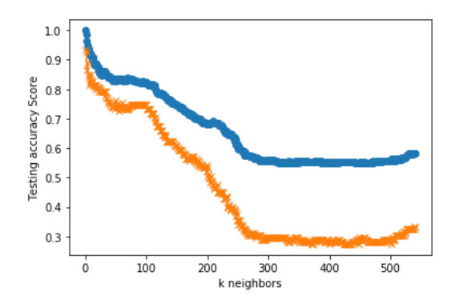
K Nearest Neighbors (KNN)
Goal: Predict passenger increase/decrease based on delay data
Created model using KNeighborsClassifier from Scikit-Learn
Reshaped and scaled data
SMOTE() needed to address testing/training sample imbalance
No decreases until an extremely high number of delays

Slide 9
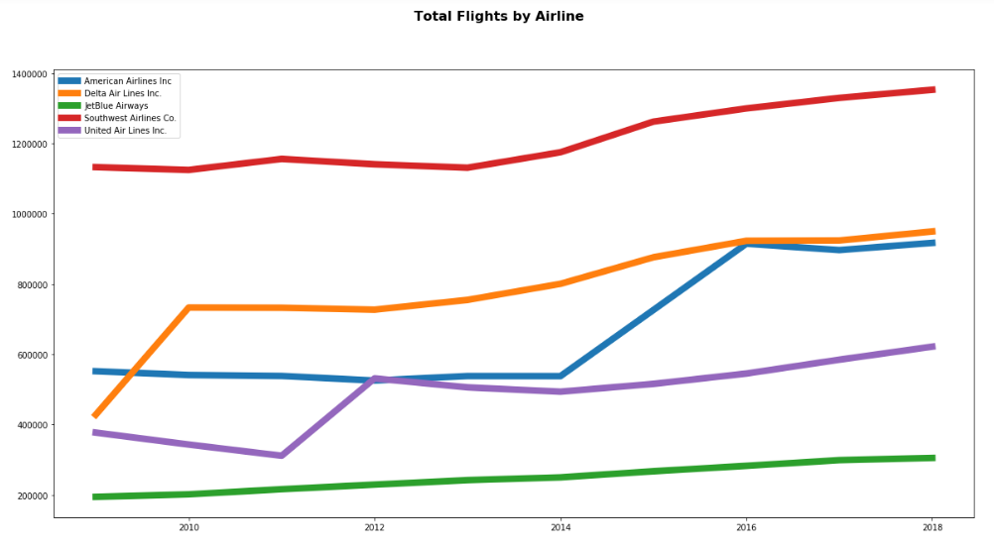
Total Overall Flights

Slide 10
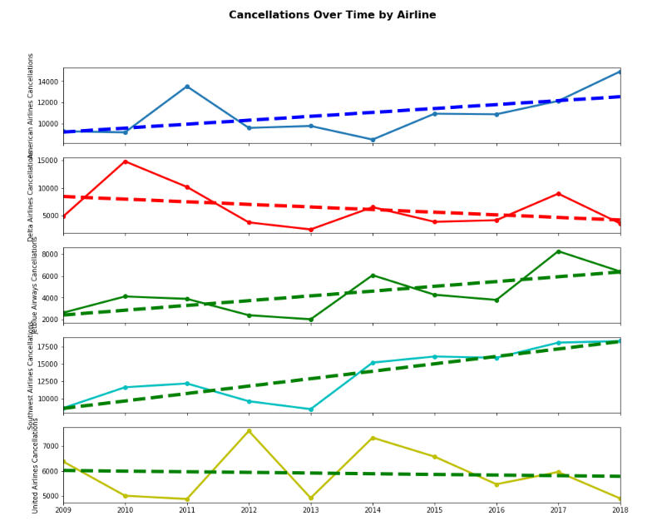
2019 Cancellations Predictions

Slide 11

2019 Cancellations Predictions
Used linear regression to determine total cancellations
for each airline in 2019.

Slide 12
Tableau
Tableau Public – Please click
HERE!

Slide 13
Logistic Regression
Learning Points / Challenges
Data
  Needed to be numeric
  Exception: Y Value (last column “inc_dec” = string)
  Difference = Calculated as a running difference for same month year over year for all 12 months
  Actual starting and ending passenger count not used to avoid skewing the data with extreme values
    Accounted for variations in ticket sales from month-to-month by using same month-diff-year comparison

Slide 14
Logistic Regression
Learning Points / Challenges
Original prediction was supposed to be what price point (ticket price) is significant enough to result in an increase or decrease in ticket sales (passenger volume)
  Bureau of Transportation Statistics does not catalog average ticket prices
  Individual carriers do not post their average ticket prices

Slide 15
Logistic Regression
Learning Points / Challenges
Prior to our final Machine Learning methodology, we used different variations of the data:
  removed certain rows and columns
  manually removed outlier values
  manipulated data to show an equal or greater amount of "decrease” compared to "increase"
Used with a StandardScaler as well as WITHOUT a StandardScaler

Slide 16
Technology Used
Python Pandas
Scikit-Learn
Matplotlib
Jupyter Notebook
Tableau
PostgreSQL

Slide 17
Congratulations!
Monday/Wednesday Class
We all made it!

